Slide 1

Generator - Measure Memory Usage

Slide 2
Reference
memory_profiler
Python Documentation on sum
Youtube
Code

Slide 3
Generators are used when playing with data volumes that don't fit in memory. No one cares about execution time when using generators. It's about memory.

Slide 4
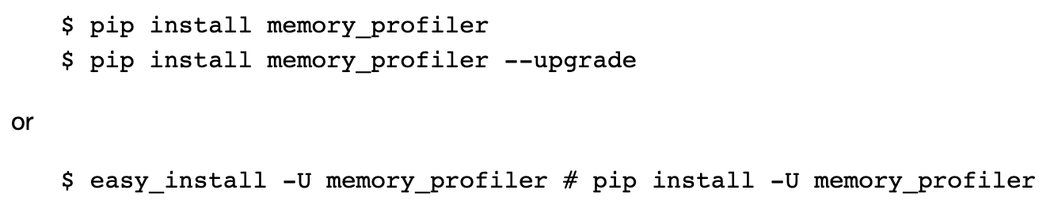
memory_profiler

Slide 5
List Up 1000000 People

Slide 6
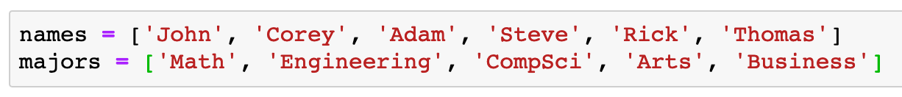

Slide 7
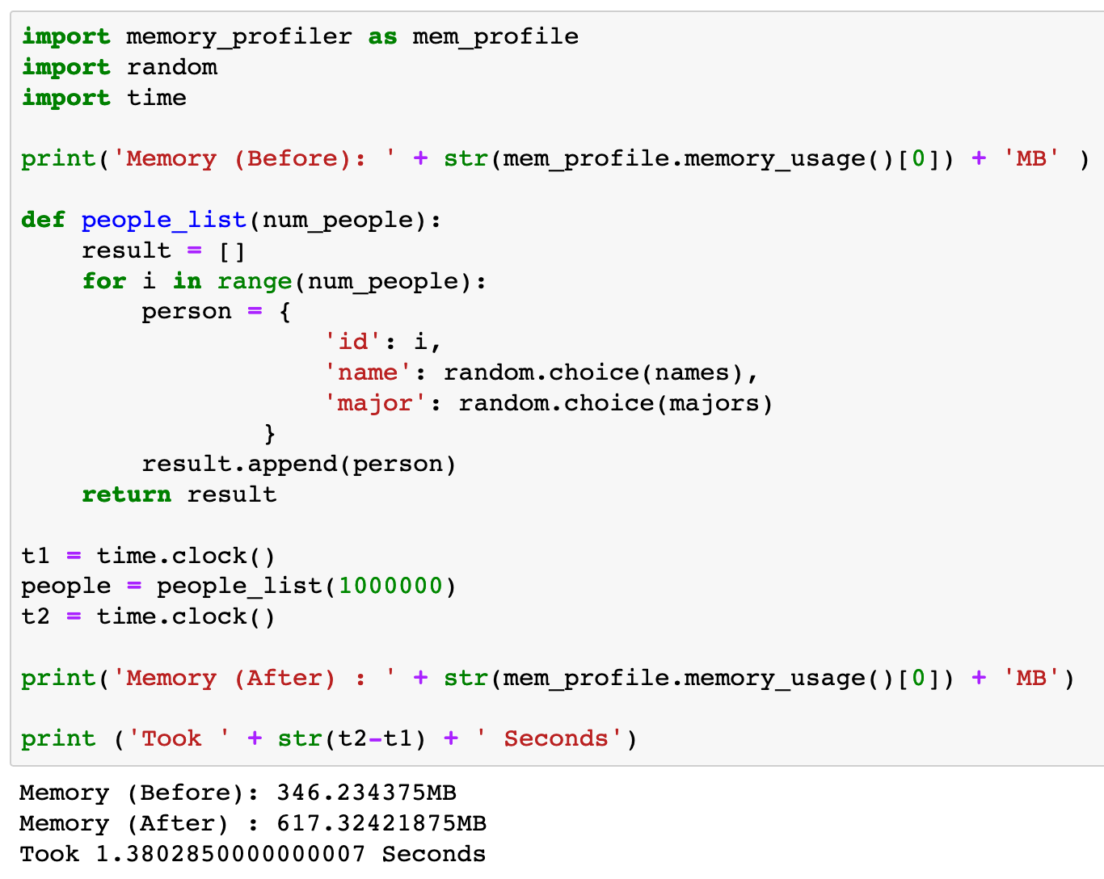

Slide 8
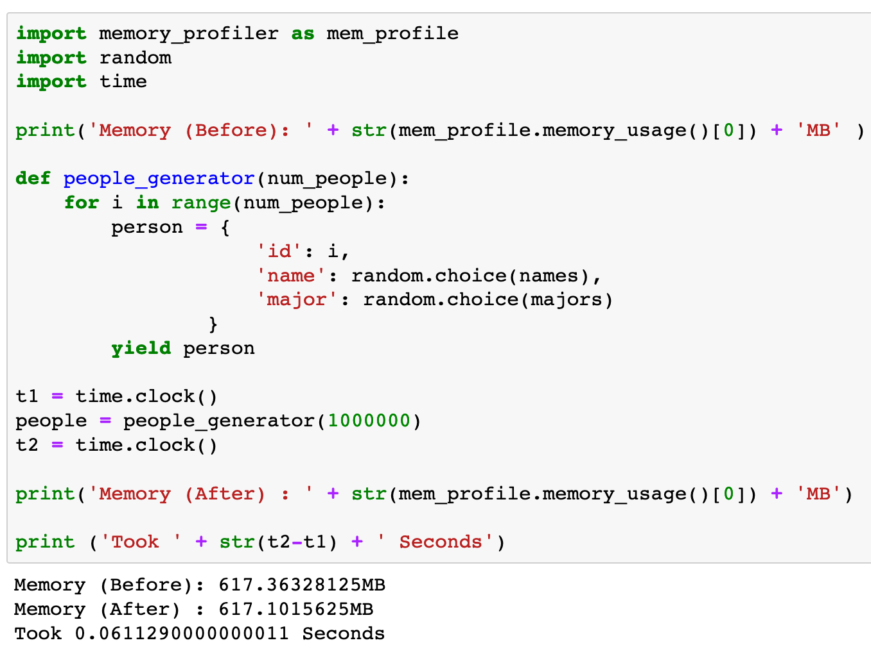

Slide 9
Count Number of Integers divisible by 3

Slide 10
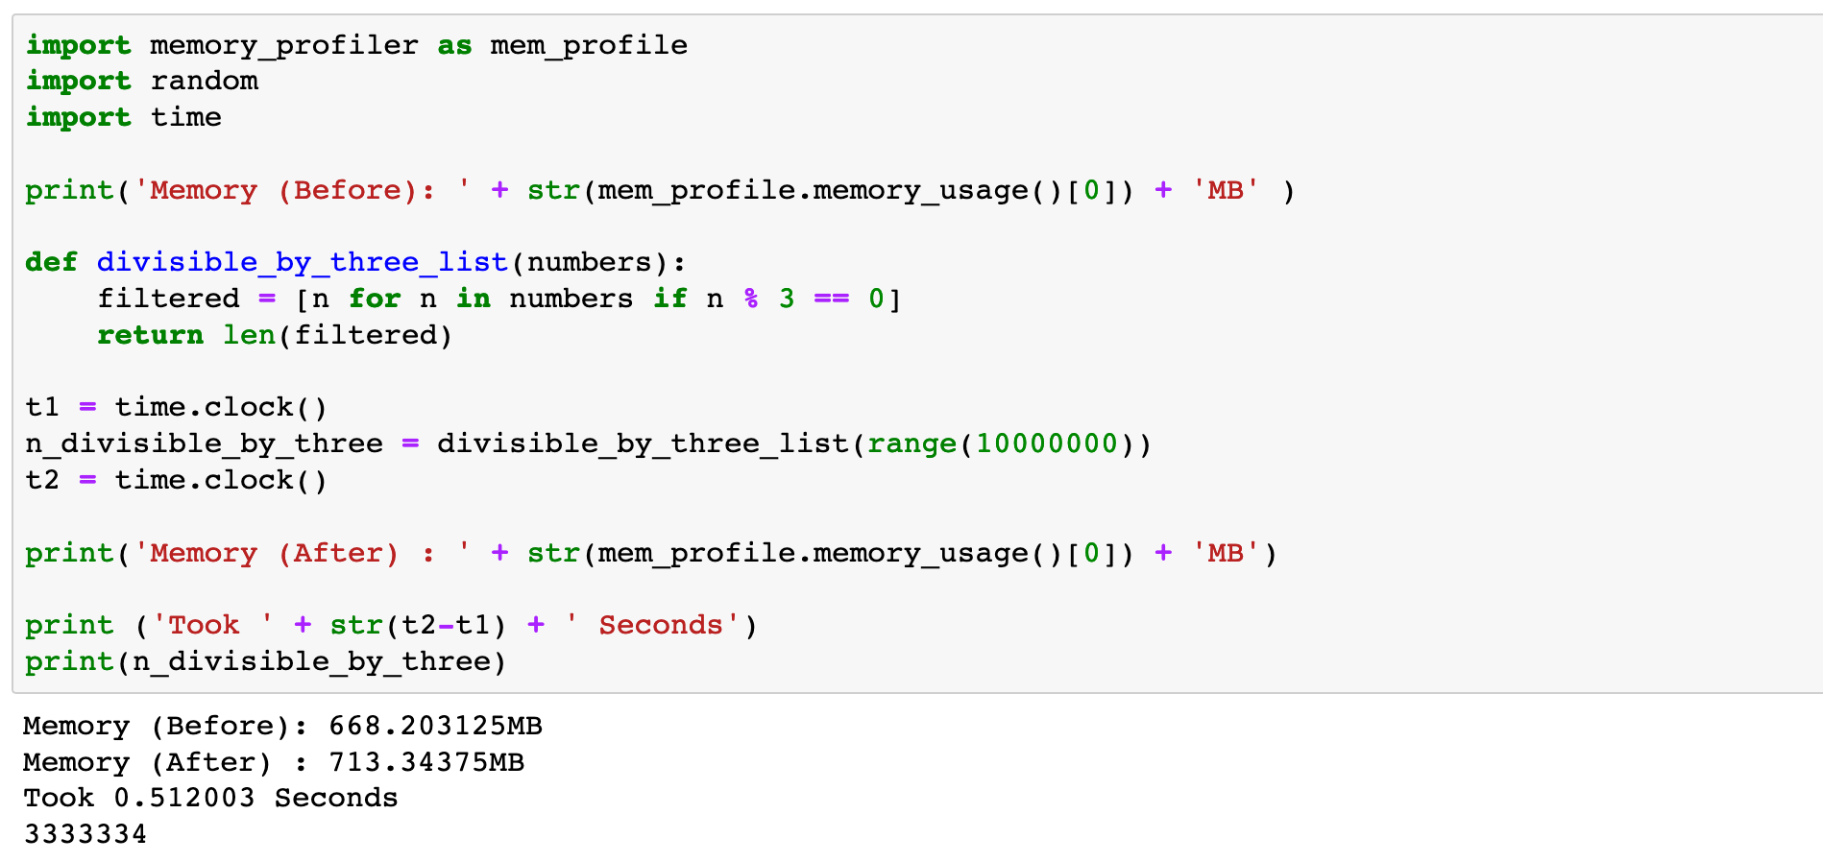

Slide 11
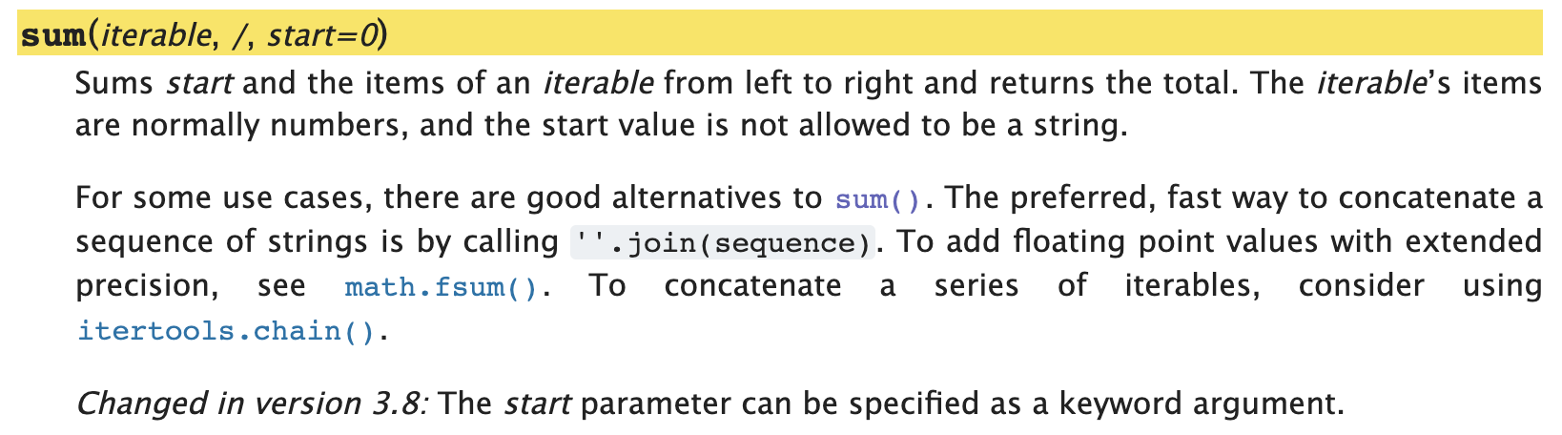
Python Documentation

Slide 12
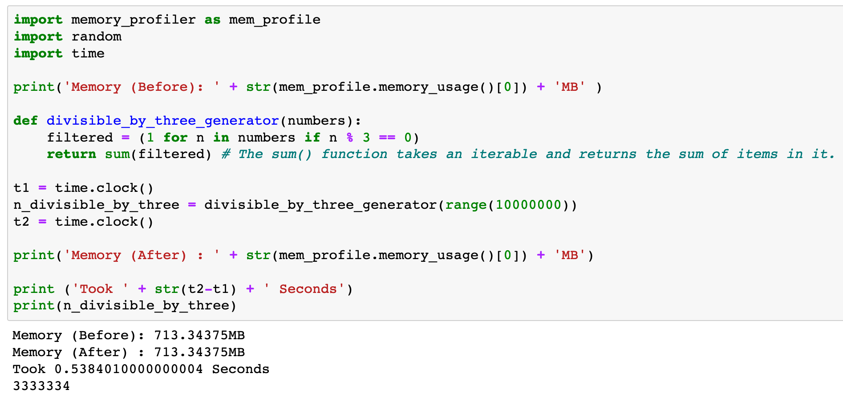

Slide 13
Now
Let’s Play with Code

